Slide 1


Simple Multi-User Chat System
GROUP 3
Matt Laskowski, Marco Orallo, Mike Fillinger

Slide 2
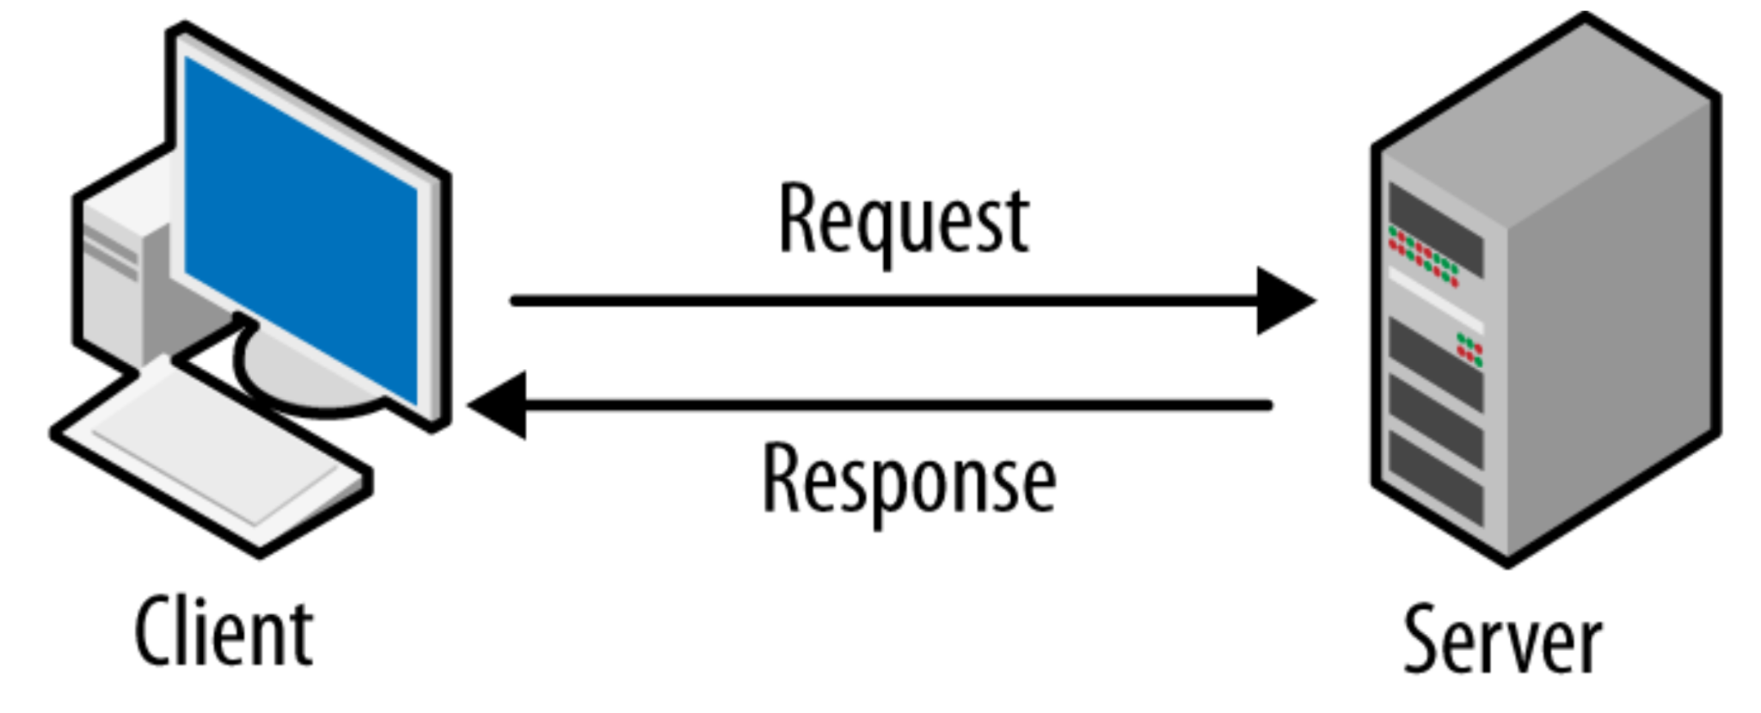
Overview
This project implements a basic client-server chat application in Python, enabling multiple users to connect and communicate in real-time.
It consists of two components:
Client Code: Handles user input, nickname selection, and message sending.
Server Code: Manages client connections, broadcasts messages, handles password, max clients and handles disconnections.
See next slide for more

Slide 3
Client Features
Nickname Selection:
Users choose a nickname when they start the client.
The server associates the nickname with the user for personalized messages.
Password Function:
Password is “password” for all users
If password is incorrect, will disconnect the client
If password is correct, client will enter chatroom with their nickname
Messaging:
Users can send messages that are instantly broadcast to all connected clients.
Error Handling:
Maximum of 5 clients are allowed at a time

Slide 4
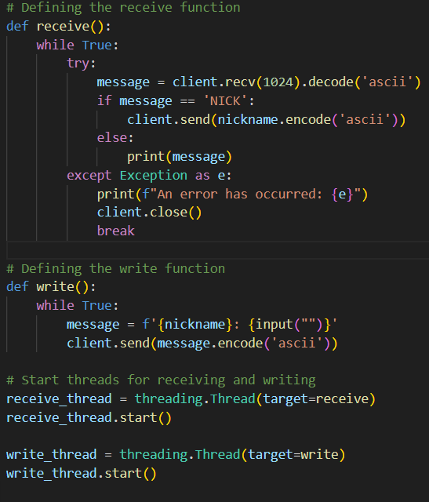
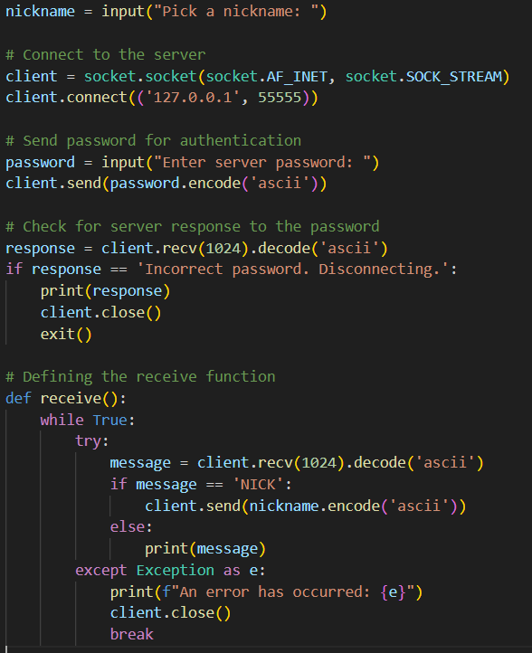

Slide 5
Server Features
Multi-Client Support:
The server handles multiple clients at the same time.
User Connection Management:
Accepts new connections and associates them with user-defined nicknames.
Asks users to enter the password, if password is correct, the client enters the chatroom.
5-client limit to avoid server overload. Server checks if the limit is reached, if it is then the server sends a message to the client, then disconnects it.
Broadcast Functionality:
Sends messages to all connected clients.
Disconnection Handling:
Detects when a client disconnects and notifies all users about the disconnection.

Slide 6
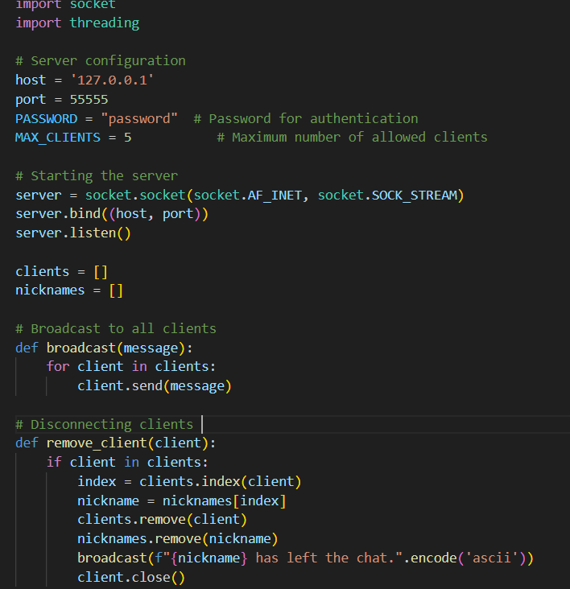
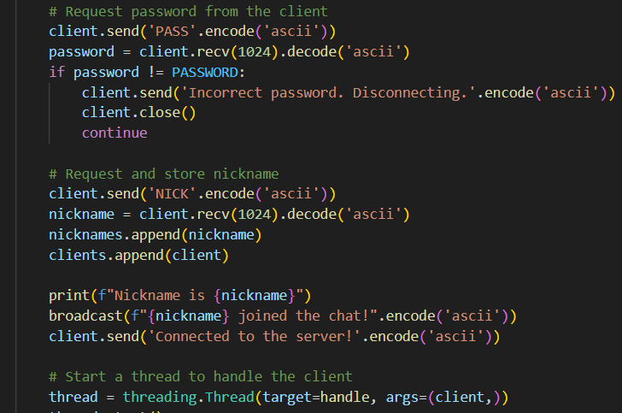

Slide 7
Interaction between Client and Server
Connection Setup:
The client connects to the server using a specified IP address (127.0.0.1) and port (55555).
The server sends a "NICK" request to obtain the user's nickname.
Then sends the password prompt. Enter “password” to enter.
Message Exchange:
Messages entered on the client are sent to the server.
The server broadcasts the message to all connected clients.
Disconnection:
When a user disconnects, the server updates the client list and notifies remaining users.
Next slide for demonstration ->

Slide 8
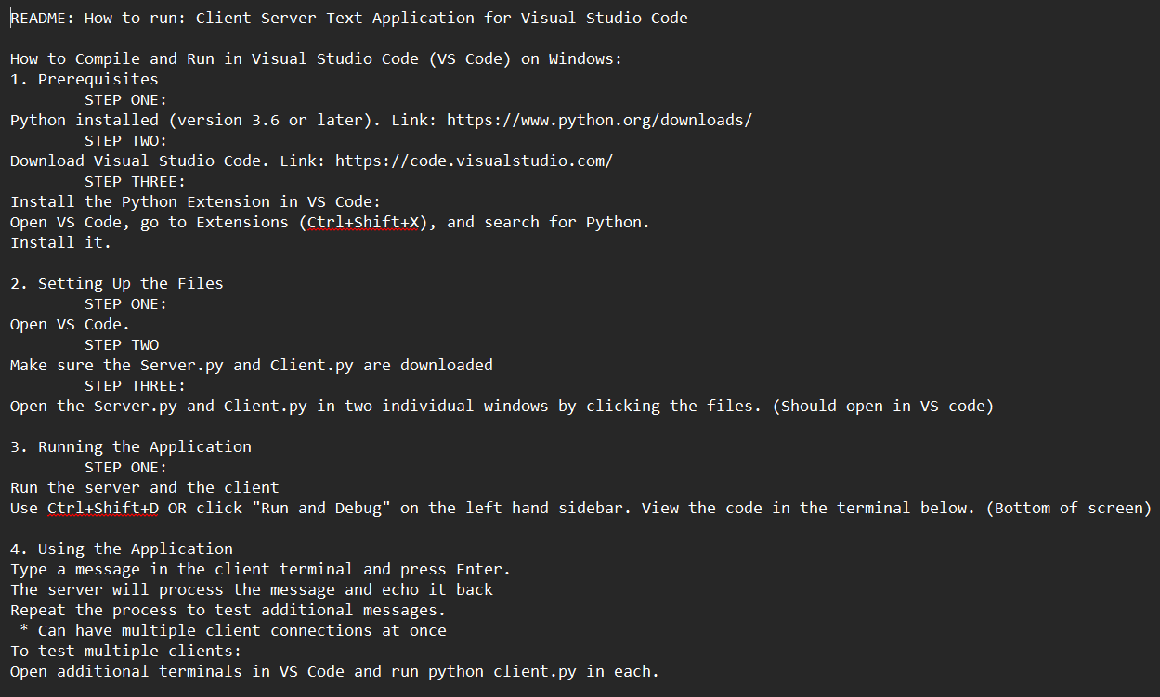
Demo:
https://github.com/mlask2/CSI2470_project

Slide 9
Questions?

